Slide 1
WEB DESIGNING

Slide 2
CONTENTS
HTML
CSS
BOOTSTRAP
JAVASCRIPT
JQUERY

Slide 3
INTRODUCTION
Web designing is the process of planning, conceptualizing, and implementing the plan for designing a website in a way that is functional and offers a good user experience.

Slide 4
Web Designing VS Web Developing
Web design is more about the experiential side of a website that ensures the audience finds the website useful, immersive, and engaging.
Web development, on the other hand, involves building and maintaining a website with the help of coding systems so that the website functions smoothly with no glitches.

Slide 5
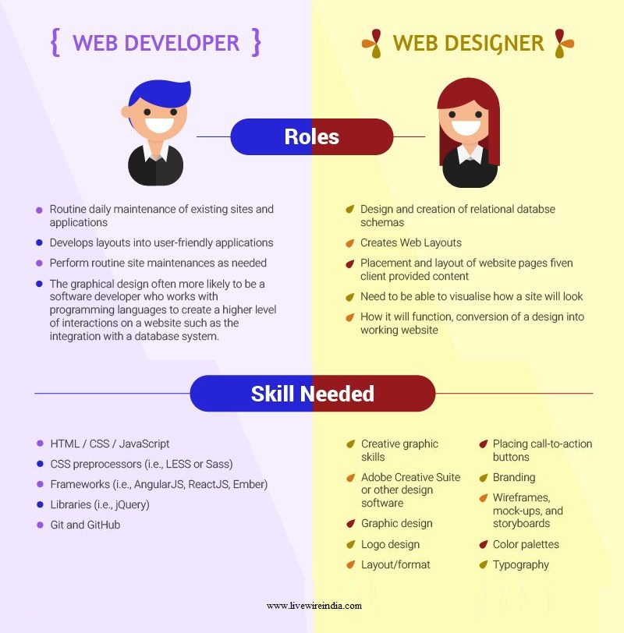

Slide 6
Types of Web Designs
The three most common types of web design are
Static web design
Dynamic web design
eCommerce web design

Slide 7
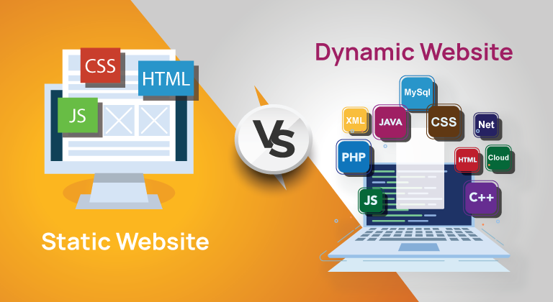

Slide 8
Web Designing Tools
Design software, such as Adobe Photoshop, Sketch, and Illustrator, used to acquire design skills.
With these tools, you can learn how to combine fonts, colors, patterns, and white space for eye-catching web design. These types of software also help with tasks like photo modification, logo design, and website layouts.

Slide 9
Technical Skills
To succeed as a web designer, it's also essential to learn about the back end of the process. Here are some of the technical skills you'll likely pick up along the way.
HTML
CSS
JAVA SCRIPT
BOOTSTRAP
JQUERY

Slide 10
HTML5 Hyper-Text Markup Language

Slide 11
Html - 5
HTML:
HTML stands for Hyper-Text-Markup-Language.
HTML is not a Programming Language but it is a Markup Language.
HTML is used to create web pages and web applications.

Slide 12
Html5 syntax
<!DOCTYPE html>
<html>
<head>
<title>Web page title</title>
</head>
<body>
</body>
</html>

Slide 13
What is a Tag?
HTML tags are like keywords which defines that how web browser will format and display the content. With the help of tags, a web browser can distinguish between an HTML content and a simple content. HTML tags contain three main parts: opening tag, content and closing tag. But some HTML tags are unclosed tags.
When a web browser reads an HTML document, browser reads it from top to bottom and left to right. HTML tags are used to create HTML documents and render their properties. Each HTML tags have different properties.

Slide 14
All HTML tags must enclosed within < > these brackets.
Every tag in HTML perform different tasks.
If you have used an open tag <tag>, then you must use a close tag </tag> (except some tags)

Slide 15
Html Elements
An HTML file is made of elements. These elements are responsible for creating web pages and define content in that webpage. An element in HTML usually consist of a start tag <tag name>, close tag </tag name> and content inserted between them. Technically, an element is a collection of start tag, attributes, end tag, content between them.

Slide 16
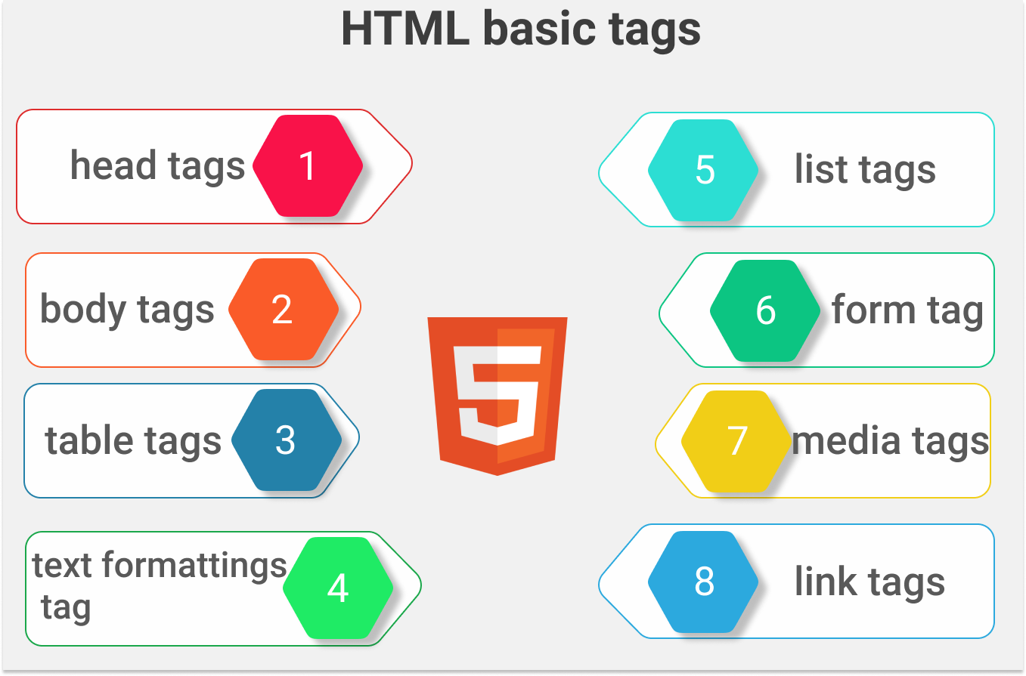

Slide 17
HTML Headings
HTML headings are titles or subtitles that you want to display on a webpage.
Properties :
Headings will always be in bold font
The contents inside heading will always start in new line.
There are 6 heading tags available.
<h1></h1> to <h6></h6>
h1 is the tag with highest font size and h6 is the tag with lowest font size.

Slide 18
Tags Used
Name | Tag | Description
Head Tags | <h1></h1> | Heading 1
 | <h2></h2> | Heading 2
 | <h3></h3> | Heading 3
 | <h4></h4> | Heading 4
 | <h5></h5> | Heading 5
 | <h6></h6> | Heading 6

Slide 19
HTML Paragraphs
A paragraph always starts on a new line, and is usually a block of text.
<p>Content</p>

Slide 20
Tag | Description
<p> | Defines a paragraph
<hr> | Defines a thematic change in the content(this is form line to given text) (There is no closing tag)
<br> | Inserts a single line break
<pre> | Defines pre-formatted text (it represent the output as same format.(ex address))

Slide 21
HTML Formatting
HTML Formatting is a process of formatting text for better look and feel. HTML provides us ability to format text without using CSS. There are many formatting tags in HTML. These tags are used to make text bold, italicized, or underlined. There are almost 14 options available that how text appears in HTML and XHTML.

Slide 22
In HTML the formatting tags are divided into two categories:
Physical tag: These tags are used to provide the visual appearance to the text.
Logical tag: These tags are used to add some logical or semantic value to the text.

Slide 23
Element name | Description
<b> | This is a physical tag, which is used to bold the text written between it.
<strong> | This is a logical tag, which tells the browser that the text is important.
<i> | This is a physical tag which is used to make text italic.
<em> | This is a logical tag which is used to display content in italic.
<mark> | This tag is used to highlight text.
<u> | This tag is used to underline text written between it.
<sup> | It displays the content slightly above the normal line.
<sub> | It displays the content slightly below the normal line.
<del> | This tag is used to display the deleted content.
<big> | This tag is used to increase the font size by one conventional unit.
<small> | This tag is used to decrease the font size by one unit from base font size.
<center> | This tag is used to center align the text.

Slide 24
HTML Styles
The HTML style attribute is used to add styles to an element, such as color, font, size, and more.

Slide 25
HTML Colors
HTML colors are specified with predefined color names, or with RGB, HEX, HSL, RGBA, or HSLA values.
Example:
Tomato
Orange
SlateBlue
Gray
DodgerBlue
MediumSeaGreen
Violet
LightGray
wheat

Slide 26
HTML Quotations
The Quotation elements in HTML are used to insert quoted texts in a web page, that is, portion of texts different from the normal texts in the web page.

Slide 27
Tags Used
Tag | Description
<blockquote></blockquote> | The block format is a freestanding quote that does not include quotation marks.
<q></q> | Defines a short quotation.
<abbr></abbr> | Used to define Abbreviations
<address></address> | Used for Contact Information(show in single line)
<cite></cite> | For work cite
<bdo></bdo> | BDO stands for Bi-Directional Override. Defines the text direction (dir=(“ltr “and “rtl”))

Slide 28
HTML Comments
HTML comments are not displayed in the browser, but they can help document your HTML source code.
Tag :
<!-- Comments to be Given -->

Slide 29
HyperLink Tag
The HTML <a> tag defines a hyperlink.
The most important attribute of the <a> element is the href, which indicates the link's destination.

Slide 30
Attribute Used with <a>
Attribute | Types | Description
target | _self | Default. Opens the document in the same window/tab as it was clicked
 | _blank | Opens the document in a new window or tab

Slide 31
Media Tags
<audio> is an inline element that is used to embed sound files into a web page.
<video> is used to embed video files into a web page.
<audio src=“file location.mp3” controls></audio>
<video src=“file location.mp4” controls></video>

Slide 32
Attributes used with Media Tags.
Attribute | Description
src | Includes the source file
Height/Width | Defines the width and height
Controls | Enables the control over audio/video.

Slide 33
Image Tag
The <img> tag is used to embed an image in an HTML page.
<img src=“image url or location” alt=“alternate text”>
<figure> element to mark up a photo in a document, and a <figcaption> element to define a caption for the photo:
<figure>
<img src=“location” alt=“alternate text”>
<figcaption>Image Caption</figcaption>
</figure>

Slide 34
Attributes used with Image
Attribute | Description
src | src - Specifies the path to the image
alt | Specifies an alternate text for the image, if the image for some reason cannot be displayed
Width/height | Specifies the width and height of the image to be displayed.

Slide 35
HTML Lists
HTML lists allow web developers to group a set of related items in lists.
There are 3 types of Lists in HTML
Ordered List (OL)
Un-Ordered List (UL)
Description List (DL)

Slide 36
List Tags
Tag | Description
<ol></ol> | Defines an Ordered List
<ul></ul> | Defines an Un-Ordered List
<dl></dl> | Defines a Description List
<dt></dt> | Defines a term in a description list
<dd></dd> | Describes the data in a description list
<li></li> | Defines a list items

Slide 37
Attributes used with list tags
We can use all the global attributes with list tags
Apart from global we can use the following attributes,
<ol type=“I”/”I”/”1”/”a”/’A’>
<ul type=“disc(default)”,”square”,”circle”,”none”>

Slide 38
Division Tag
open division tag<div> closing tag</div>
used to split the partition.

Slide 39
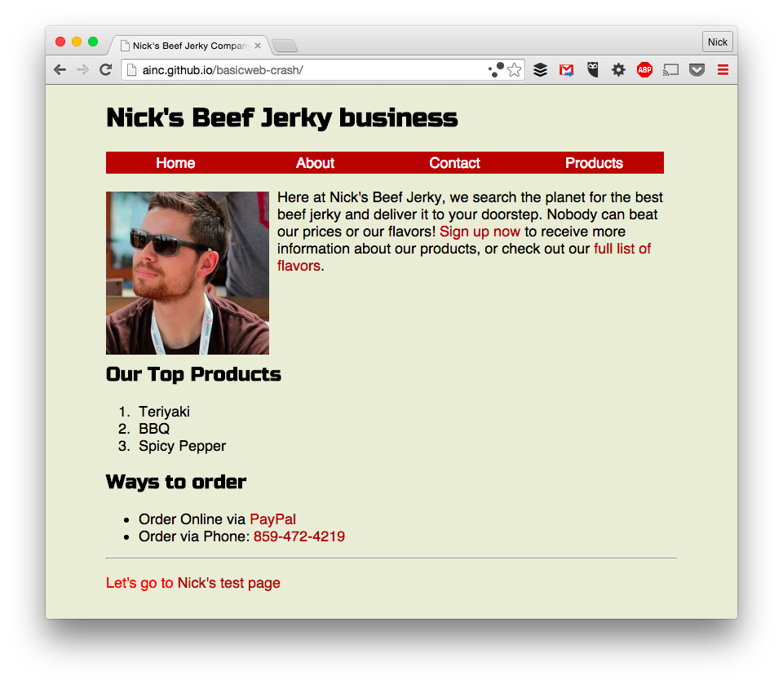
Mini Projects

Slide 40
Mini Project
Design a Photographic Page using the concepts you’ve studied.
Example :
“https://jolly-kalam-23776e.netlify.app/photographysite/#images”

Slide 41
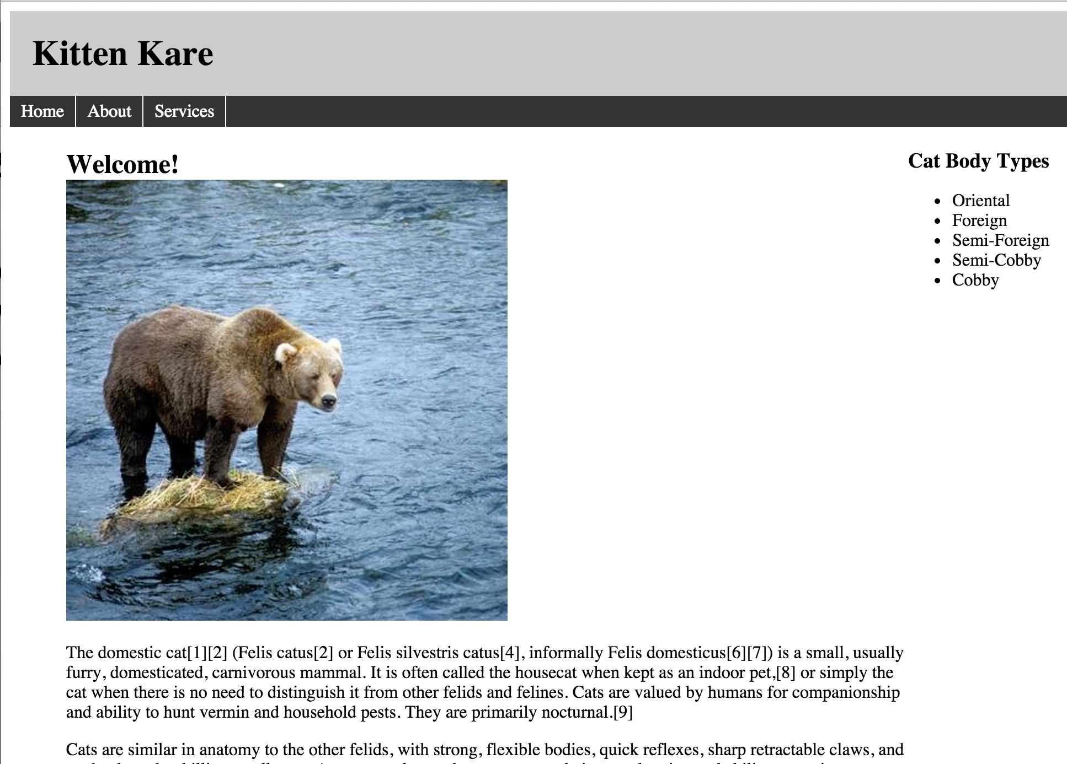
Practice

Slide 42
HTML Table
HTML tables allow web developers to arrange data into rows and columns.

Slide 43
Table Tags
Tag | Description
<table> | Defines a table
<th> | Defines a header cell in a table
<tr> | Defines a row in a table
<td> | Defines a cell in a table
<caption> | Defines a table caption
<colgroup> | Specifies a group of one or more columns in a table for formatting
<col> | Specifies column properties for each column within a <colgroup> element
<thead> | Groups the header content in a table
<tbody> | Groups the body content in a table
<tfoot> | Groups the footer content in a table

Slide 44
Attributes used with table
We can use all the global attributes
Apart from global attributes we have,
bgcolor
background
colspan
rowspan
width
border
span

Slide 45
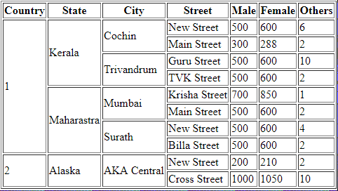
Practice

Slide 46
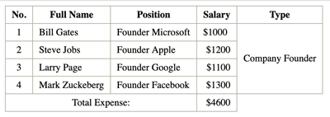
Practice

Slide 47
HTML Forms
An HTML form is used to collect user input. The user input is most often sent to a server for processing.<form></form>

Slide 48
Form Elements
<input>
<label>
<select>
<option>
<textarea>
<button>
<fieldset>
<legend>
<datalist id=‘’>
<output>

Slide 49
HTML Input Types
<input type="text">
<input type="number">
<input type="password">
<input type="email">
<input type="date">
<input type="datetime-local">
<input type="time">
<input type="week">
<input type="month">
<input type="checkbox">
<input type="radio">

Slide 50
<input type="color">
<input type="file">
<input type="range">
<input type="hidden">
<input type="image">
<input type="tel">
<input type="search">
<input type="url">
<input type="button">
<input type="reset">
<input type="submit">

Slide 51
Attribute | Description | Input Type Used
Value | Used to give default value to an input | All input types
Readonly | Makes the input as read only format | All input types
Disabled | Cannot be selected, copied, edited | All input Types
Size | Specifies the visible width of an input | Text, search, tel, url, email, and password.
Maxlength | Specifies the maximum number of characters allowed in an input field. | All types (mainly in text)
Min & Max | Minimum and Maximum values for the input | Number, range, date, datetime-local, month, time and week.
Multiple | Allows user to select or give multiple values | Email, File
Required | Specifies that an input field must be filled out before submitting the form | text, search, url, tel, email, password, date pickers, number, checkbox, radio, and file.

Slide 52
Attribute | Description | Input Tags Used
Placeholder | Describes the expected value of an input field | Text, search, url, tel, email, and password.
Step | Specifies the legal number intervals for an input field. | Number, range, date, datetime-local, month, time and week.
Autofocus | Specifies that an input field should automatically get focus when the page loads. | All Type of Input
Height & Width | Specify the height and width of an element. | Image
List | Refers to a <datalist> element that contains pre-defined options for an <input> element. | Datalist, Option Tags
Auto-complete | Autocomplete allows the browser to predict the value. When a user starts to type in a field, the browser should display options to fill in the field, based on earlier typed values. | Text, search, url, tel, email, password, datepickers, range, and color.

Slide 53
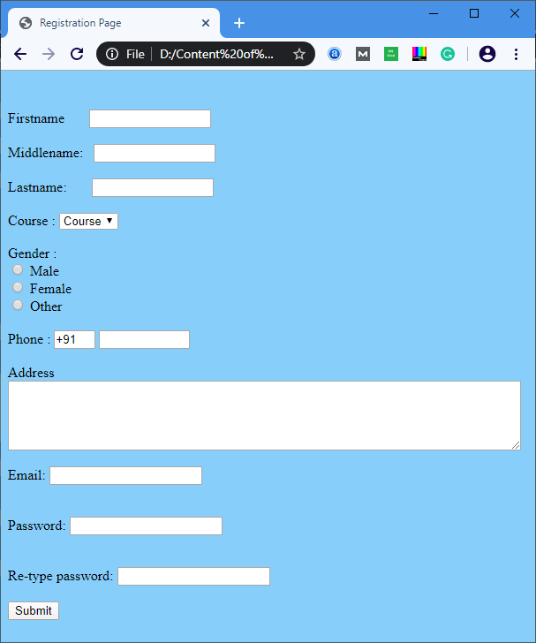
Do a simple Registration Form using HTML

Slide 54
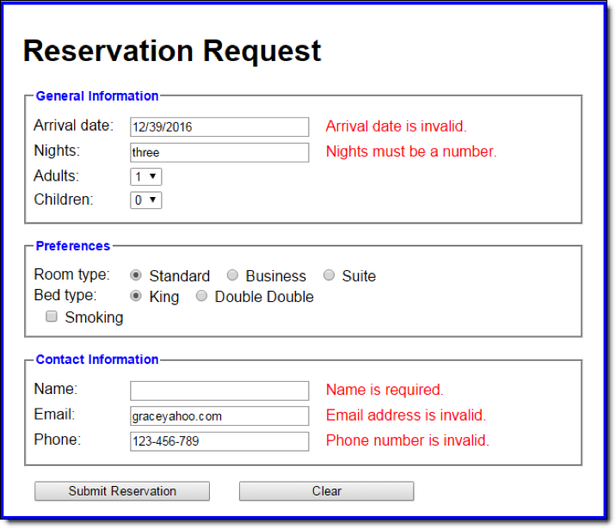
Practice

Slide 55
HTML Attributes
Id – This attribute is used to identify uniquely each element within an HTML page.
Class – This attribute is used to associate an element with a style sheet and specifies the class of element. It can be used with Java script also.
Style – It is to specify CSS rules within the element.

Slide 56
HTML Classes
class attribute is used to specify a class for an HTML element.
Multiple HTML elements can share the same class.
. is used to mention the class of an element in css

Slide 57
Example
<style type=“text/css”>
.a{ background-color: yellow;
}
</style>
<div class = “a”>Hello</div>

Slide 58
HTML ID
Id attribute is used to specify a unique id for an HTML element.
You cannot have more than one element with the same id in an HTML document.
The syntax for id is: write a hash character (#), followed by an id name.

Slide 59
Example
<style>
#a{ background-color: yellow;
}
</style>
<div id= “a”>Hello</div>

Slide 60
HTML Layout
Websites often display content in multiple columns (like a magazine or a newspaper).
HTML has several semantic elements that define the different parts of a web page

Slide 61
Layout Elements
Element | Description
<header></header> | Defines a header for a document or a section
<nav></nav> | Defines a set of Navigation Links
<section></section> | Defines a section in a document
<article></article> | Defines an Independent Content
<aside></aside> | Defines content aside from the content
<footer></footer> | Defines a footer for a document or a section
<details></details> | Defines additional details that the user can open and close on demand
<summary></summary> | Defines a heading for the <details> element

Slide 62
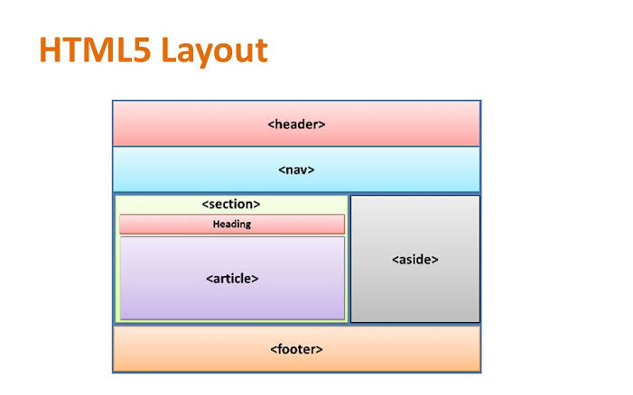

Slide 63
HTML Semantic
In any language, it is essential to understand the meaning of words during communication. And if this is a computer communication then it becomes more critical. So HTML5 provides more semantic elements which make easy understanding of the code.
Semantic elements= elements with a meaning. Semantic elements have a simple and clear meaning for both, the browser and the developer.

Slide 64
Index | Semantic Tag | Description
1. | <article> | Defines an article
2. | <aside> | Defines content aside from the page content
3. | <details> | Defines additional details that the user can view or hide
4. | <figcaption> | Defines a caption for a <figure> element
5. | <figure> | Specifies self-contained content, like illustrations, diagrams, photos, code listings, etc.
6. | <footer> | Defines a footer for a document or section
7. | <header> | Specifies a header for a document or section
8. | <main> | Specifies the main content of a document
9. | <mark> | Defines marked/highlighted text
10. | <nav> | Defines navigation links
11. | <section> | Defines a section in a document
12. | <summary> | Defines a visible heading for a <details> element
13. | <time> | Defines a date/time
14 | <abbr> | Used for abbreviations

Slide 65
HTML Responsive
Responsive web design is about creating web pages that look good on all devices!
To create a responsive website, add the following <meta> tag to all your web pages:
<meta name="viewport" content="width=device-width, initial-scale=1.0">

Slide 66
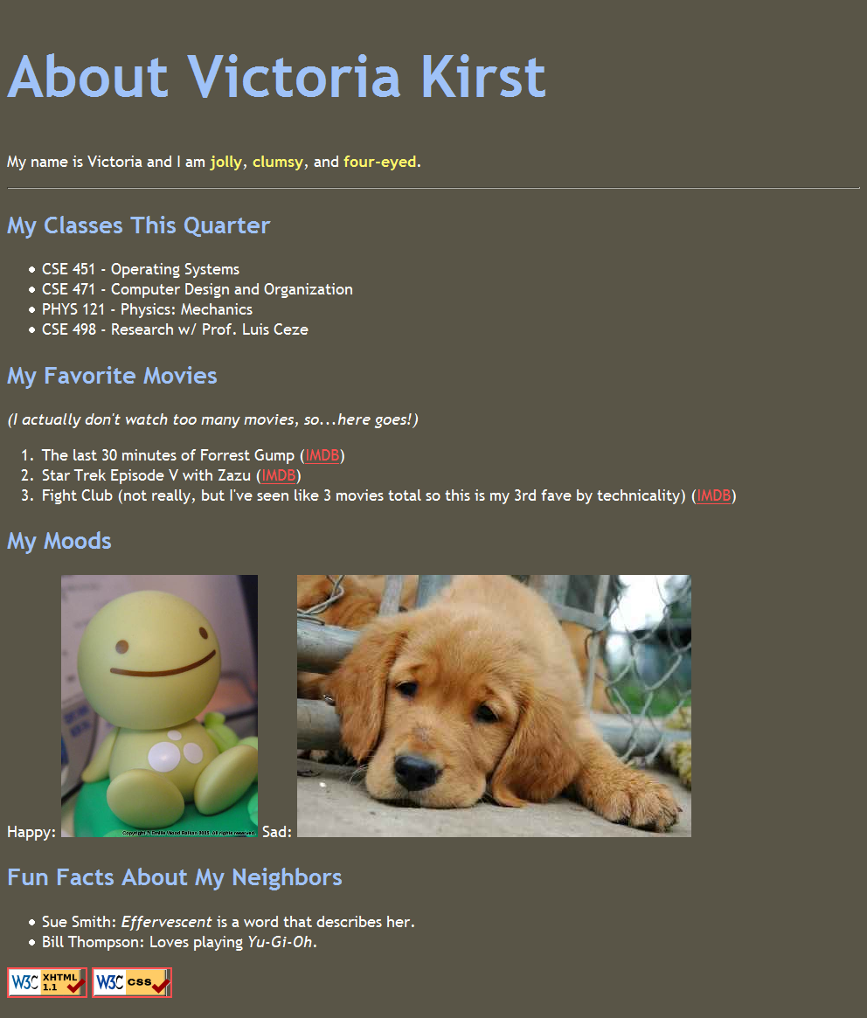

Slide 67
CSS3
Cascading Style Sheets

Slide 68
Introduction
CSS stands for Cascading Style Sheets
CSS describes how HTML elements are to be displayed on screen, paper, or in other media
CSS saves a lot of work. It can control the layout of multiple web pages all at once.

Slide 69
Ways to add CSS
There are three ways of inserting a style sheet:
Inline CSS
Internal CSS
External CSS

Slide 70
Inline CSS
An inline style may be used to apply a unique style for a single element.
To use inline styles, add the style attribute to the relevant element. The style attribute can contain any CSS property.

Slide 71
Internal CSS
An internal style sheet may be used if one single HTML page has a unique style.
The internal style is defined inside the <style> element, inside the head section.

Slide 72
External CSS
With an external style sheet, you can change the look of an entire website by changing just one file!
Each HTML page must include a reference to the external style sheet file inside the <link> element, inside the head section.

Slide 73
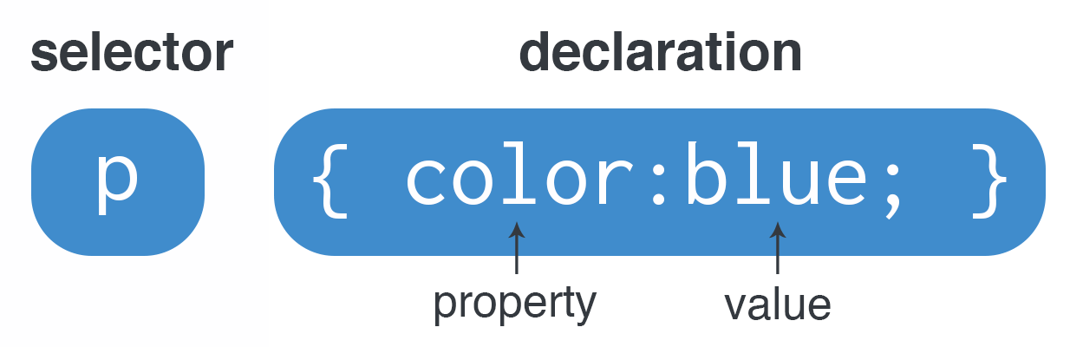
Syntax

Slide 74
Comments
CSS comments are not displayed in the browser, but they can help document your source code.
A CSS comment is placed inside the <style> element, and starts with /* and ends with */

Slide 75
Pre-Defined Colors
CSS/HTML support 140 standard color names.
Example:
Tomato
Alice Blue
Antique white
Aqua
Aquamarine
Chocolate
Dark Slate Gray
Green Yellow
Light Blue etc……

Slide 76
CSS Colors
Colors are specified using predefined color names, or RGB, RGBA, HEX, HSL, HSLA values.

Slide 77
CSS RGB Colors
In CSS, a color can be specified as an RGB value, using this formula,
rgb(red, green, blue)
Example:
rgb(15, 140, 244)

Slide 78
RGBA Value
RGBA color values are an extension of RGB color values with an alpha channel - which specifies the opacity for a color.
An RGBA color value is specified with,
rgba(red, green, blue, alpha)
note: alpha value in 0.1 ~1

Slide 79
CSS Hex Value
In CSS, a color can be specified using a hexadecimal value in the form
#rrggbb
Example:
#0F8CF4

Slide 80
CSS HSL Value
HSL stands for hue, saturation, and lightness.
hsl(hue, saturation, lightness)
Hue is a degree on the color wheel from 0 to 360. 0 is red, 120 is green, and 240 is blue.
Saturation is a percentage value, 0% means a shade of gray, and 100% is the full color.
Lightness is also a percentage, 0% is black, 50% is neither light or dark, 100% is white

Slide 81
HSLA Color Values
HSLA color values are an extension of HSL color values with an alpha channel - which specifies the opacity for a color.
An HSLA color value is specified with:
hsla(hue, saturation, lightness, alpha)

Slide 82
Backgrounds
The CSS background properties are used to add background effects for elements. A background can be any one of these:
background-color
background-image

Slide 83
Background Properties:
background –repeat-x,repeat-y,no-repeat.
background-Position: top; (top,bottom,right,left)
background-attachement;fixed
background-size:100%;

Slide 84
Border
The border-style property specifies what kind of border to display.
Border Properties :
border-color
border-radius
border-style
border-width
border-top-left-radius
border-bottom-left-radius
border-top-right-radius
border-bottom-right-radius
border

Slide 85
Borders in CSS
Style | Description
Dotted | Defines a dotted border
Dashed | Defines a dashed border
Solid | Defines a solid border
Double | Defines a double border
Groove | Defines a 3D grooved border. The effect depends on the border-color value
Ridge | Defines a 3D ridged border. The effect depends on the border-color value
Inset | Defines a 3D inset border. The effect depends on the border-color value
Outset | Defines a 3D outset border. The effect depends on the border-color value
None | Defines no border
Hidden | Defines a hidden border

Slide 86
CSS Outline
An outline is a line drawn outside the element's border.
Properties:
outline-style
outline-color
outline-width
outline-offset
outline

Slide 87
Outline Properties
Property | Description
outline-style | specifies the style of the outline
outline-color | specifies the color of the outline
outline-width | specifies the width of the outline
outline-offset | property adds space between an outline and the edge/border of an element.
outline | Shorthand method to give all the properties of outline.

Slide 88
Margins
The CSS margin properties are used to create space around elements, outside of any defined borders.
With CSS, you have full control over the margins. There are properties for setting the margin for each side of an element (top, right, bottom, and left).

Slide 89
Properties
Property | Description
Margin | A shorthand property for setting all the margin properties in one declaration
Margin-left | Sets the left margin of an element
Margin-right | Sets the right margin of an element
Margin-top | Sets the top margin of an element
Margin-Bottom | Sets the bottom margin of an element

Slide 90
Padding
Padding is used to create space around an element's content, inside of any defined borders.

Slide 91
Padding Properties
Property | Description
padding | A shorthand property for setting all the padding properties in one declaration
padding-bottom | Sets the bottom padding of an element
padding-left | Sets the left padding of an element
padding-right | Sets the right padding of an element
padding-top | Sets the top padding of an element

Slide 92
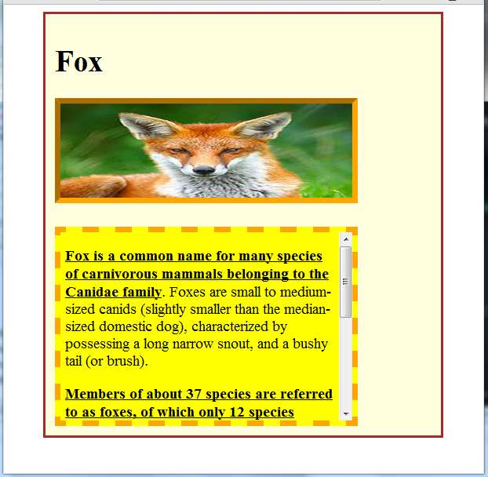
Practice

Slide 93
Width and Height Properties
The CSS height and width properties are used to set the height and width of an element.
The CSS max-width property is used to set the maximum width of an element.

Slide 94
Width/Height Properties
Property | Description
height | Sets the height of an element
max-height | Sets the maximum height of an element. Cannot exceeds the original height
max-width | Sets the maximum width of an element. Cannot exceeds the original width
min-height | Sets the minimum height of an element. Cannot be lower than the original height
min-width | Sets the minimum width of an element. Cannot be lower than the original width
width | Sets the width of an element

Slide 95
CSS Text
CSS has a lot of properties for formatting text.
Color
Font
Alignment
Spacing
Shadow etc….

Slide 96
Text Properties
Property | Sub-Property | Description
Color | color | Defines a font color
 | background-color | Defines a background color
Alignment | text-align | Sets Horizontal alignment
 | text-align-last | property specifies how to align the last line of a text.
Decoration | text-decoration-line | Used to add a decoration line to text
 | text-decoration-color | Used to set the color of the decoration line
 | text-decoration-style | Used to set the style of the decoration line
 | text-decoration-thickness | set the thickness of the decoration line

Slide 97
Property | Sub Properties | Description
Transformation | text-transform | It can be used to turn everything into uppercase or lowercase letters, or capitalize the first letter of each word
Text Spacing | text-indent | specify the indentation of the first line of a text
 | letter-spacing | specify the space between the characters in a text
 | line-height | specify the space between lines
 | word-spacing | specify the space between the words in a text
 | white-space | specifies how white-space inside an element is handled
Text Shadow | text-shadow | property adds shadow to text. In its simplest use, you only specify the horizontal shadow (2px) and the vertical shadow (2px)

Slide 98
CSS Font
In CSS there are five generic font families:
Serif fonts have a small stroke at the edges of each letter. They create a sense of formality and elegance.
Sans-serif fonts have clean lines (no small strokes attached). They create a modern and minimalistic look.
Monospace fonts - here all the letters have the same fixed width. They create a mechanical look.
Cursive fonts imitate human handwriting.
Fantasy fonts are decorative/playful fonts.
check

Slide 99
Font Families
Generic Font Family | Examples of Font Names
Serif | Times New Roman Georgia Garamond
Sans-serif | Arial Verdana Helvetica
Monospace | Courier New Lucida Console Monaco
Cursive | Brush Script MT Lucida Handwriting
Fantasy | Copperplate Papyrus

Slide 100
Font Properties
Property | Description
font-style | property is mostly used to specify italic text.
font-weight | property specifies the weight of a font
font-size | property sets the size of the text

Slide 101
CSS Links
Links can be styled with any CSS property (e.g. color, font-family, background, etc.).

Slide 102
Properties
Property | Description
a:link | a normal, unvisited link
a:visited | a link the user has visited
a:hover | a link when the user mouse over it
a:active | a link the moment it is clicked

Slide 103
CSS Tables
The look of an HTML table can be greatly improved with CSS using the following properties
Borders
Size
Alignment
Responsive

Slide 104
Table Properties
Border : The border-collapse property sets whether the table borders should be collapsed into a single border.
Width/Height : The width and height of a table are defined by the width and height properties.
Alignment : The text-align property sets the horizontal alignment (like left, right, or center) of the content in <th> or <td>.
Vertical-Alignment : The vertical-align property sets the vertical alignment (like top, bottom, or middle) of the content in <th> or <td>(use height min 50px)

Slide 105
Table Styles
Style | Description
padding | To control the space between the border and the content in a table, use the padding property
Horizontal Dividers | Add the border-bottom property to <th> and <td> for horizontal dividers
Hoverable Table | Use the :hover selector on <tr> to highlight table rows on mouse over
Striped Tables | For zebra-striped tables, use the nth-child() selector and add a background-color to all even (or odd) table rows

Slide 106
CSS Display
The display property is the most important CSS property for controlling layout.
Every HTML element has a default display value depending on what type of element it is. The default display value for most elements is block or inline-block.

Slide 107
CSS Float
The float property is used for positioning and formatting content e.g. let an image float left to the text in a container.
The float property can have one of the following values:
left - The element floats to the left of its container
right - The element floats to the right of its container
none - The element does not float (will be displayed just where it occurs in the text). This is default
inherit - The element inherits the float value of its parent

Slide 108
Box Sizing
The CSS box-sizing property allows us to include the padding and border in an element's total width and height.
By default, the width and height of an element is calculated like this:
width + padding + border = actual width of an element height + padding + border = actual height of an element
This means: When you set the width/height of an element, the element often appears bigger than you have set (because the element's border and padding are added to the element's specified width/height).
The box-sizing property solves this problem

Slide 109
Property
The box-sizing property allows us to include the padding and border in an element's total width and height.
If you set box-sizing: border-box; on an element, padding and border are included in the width and height.

Slide 110
CSS Images
Border and Radius:
These Properties will help you to style your images.
Use the border-radius property to create rounded images
Use the border property to create thumbnail images

Slide 111
Responsive Images
Responsive images will automatically adjust to fit the size of the screen.
If you want an image to scale down if it has to, but never scale up to be larger than its original size. To set this we have to give max-width property as 100% and height should be auto.

Slide 112
Center an Image
To center an image, set left and right margin to auto and make it into a block element

Slide 113

Polaroid Images

Slide 114
Transparent Images
The opacity property can take a value from 0.0 - 1.0. The lower value, the more transparent

Slide 115
Filters in Images
The CSS filter property adds visual effects (like blur and saturation) to an element.
Note: The filter property is not supported in Internet Explorer or Edge 12.

Slide 116
Properties Used
Filters | Properties | Example Value
filter | Blur | 2px (By default it is 0)
 | Brightness | 0.0 to 1.0
 | Contrast | 0 to any number
 | Grayscale | 0.0 to 1.0
 | Hue-rotate | 50deg (By default 0deg)
 | Invert | 0.0 to 1.0
 | Opacity | 0.0 to 1.0
 | Saturate | 1 to any number
 | Sepia | 0.0 to 1.0
 | Drop-shadow | 2px 2px 5px (horizontal , vertical, blur)

Slide 117
Flip an Image
Transform property is used to flip the image.
Ex. transform: scaleX(-1);
transform: scaleY(-1)
transform: scale(-1) // for both x and y

Slide 118
CSS Pagination
If you have a website with lots of pages, you may wish to add some sort of pagination to each page.
left pointing double angle quotation mark:
&laquo; → <<
Right pointing double angle quotation mark:s
&raquo; → >>

Slide 119
Properties
Property | Description
Hover and active | Highlight the current page with an .active class, and use the :hover selector to change the color of each page link when moving the mouse over them
Border-Radius | Add the border-radius property if you want a rounded "active" and "hover" button.
Border | Use the border property to add borders to the pagination
First-child, last-child | Add rounded borders to your first and last link in the pagination
Margin | Add the margin property if you do not want to group the page links
Font-Size | Change the size of the pagination with the font-size property

Slide 120
CSS3 Buttons
Properties used to style the buttons
Background-color
Padding
Color
Margin
Border
Border-radius
Float
Display
Hover
Box-shadow
Width
Opacity

Slide 121
Transition
Properties :
transition-property
transition-duration
transition-delay
transition-timing-function
transition

Slide 122
Transition Timing Functions
Function | Description
ease | specifies a transition effect with a fast start and end. (default)
linear | specifies a transition effect with the same speed from start to end
ease-in | specifies a transition effect with a slow start
ease-out | specifies a transition effect with a slow end
ease-in-out | specifies a transition effect with a slow start and end

Slide 123
CSS3 Animations
CSS allows animation of HTML elements without using JavaScript or Flash!

Slide 124
Property | Description
@keyframes | Specifies the animation code
animation | A shorthand property for setting all the animation properties
animation-delay | Specifies a delay for the start of an animation
animation-direction | Specifies whether an animation should be played forwards, backwards or in alternate cycles
animation-duration | Specifies how long time an animation should take to complete one cycle
animation-iteration-count | Specifies the number of times an animation should be played
animation-name | Specifies the name of the @keyframes animation
animation-play-state | Specifies whether the animation is running or paused
animation-timing-function | Specifies the speed curve of the animation

Slide 125
Animation Directions
normal - The animation is played as normal (forwards). This is default
reverse - The animation is played in reverse direction (backwards)
alternate - The animation is played forwards first, then backwards
alternate-reverse - The animation is played backwards first, then forwards

Slide 126
Animation Timing Function
ease - Specifies an animation with a slow start, then fast, then end slowly (this is default)
linear - Specifies an animation with the same speed from start to end
ease-in - Specifies an animation with a slow start
ease-out - Specifies an animation with a slow end
ease-in-out - Specifies an animation with a slow start and end

Slide 127
Animation Fill Mode
none - Default value. Animation will not apply any styles to the element before or after it is executing
forwards - The element will retain the style values that is set by the last keyframe (depends on animation-direction and animation-iteration-count)
backwards - The element will get the style values that is set by the first keyframe (depends on animation-direction), and retain this during the animation-delay period
both - The animation will follow the rules for both forwards and backwards, extending the animation properties in both directions

Slide 128
Positions
There are five different position values:
static
relative
fixed
Absolute (used with relative in drop downs)
Sticky (used in navigation bar)

Slide 129
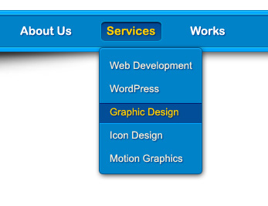
CSS Drop-Downs

Slide 130
Responsive
Responsive web design makes your web page look good on all devices.
Responsive web design uses only HTML and CSS.
Responsive web design is not a program or a JavaScript.

Slide 131
What is Media Query?
Media query is a CSS technique introduced in CSS3.
It uses the @media rule to include a block of CSS properties only if a certain condition is true.

Slide 132
Example
If the browser window is 600px or smaller, the background color will be lightblue:
@media only screen and (max-width: 600px) { body { background-color: lightblue; } }

Slide 133
Add a Breakpoint
Earlier in this tutorial we made a web page with rows and columns, and it was responsive, but it did not look good on a small screen.
Media queries can help with that. We can add a breakpoint where certain parts of the design will behave differently on each side of the breakpoint.

Slide 134
Extra small devices (phones, 600px and down) @media only screen and (max-width: 600px) {...}
Small devices (portrait tablets and large phones, 600px and up) @media only screen and (min-width: 600px) {...}
Medium devices (landscape tablets, 768px and up) @media only screen and (min-width: 768px) {...}
Large devices (laptops/desktops, 992px and up) @media only screen and (min-width: 992px) {...}
Extra large devices (large laptops and desktops, 1200px and up) @media only screen and (min-width: 1200px) {...}

Slide 135

Mini Project

Slide 136
BOOTSTRAP 4

Slide 137
What is Bootstrap?
Bootstrap is a free front-end framework for faster and easier web development
Bootstrap also gives you the ability to easily create responsive designs

Slide 138
Why Bootstrap?
Easy to use
Responsive features
Mobile-first approach
Browser compatibility

Slide 139
How to Use?
Include Bootstrap 4 from a CDN
Download Bootstrap 4 from getbootstrap.com

Slide 140
Containers
Containers are used to pad the content inside of them, and there are two container classes available:
The .container class provides a responsive fixed width container
The .container-fluid class provides a full width container, spanning the entire width of the viewport

Slide 141
Padding, Margin
The class .p-3 adds the overall padding
The class .my-3 adds the overall margin property for the container

Slide 142
Border
The class for border and colours:
.border border-primary
.border border-info
.border border-success
.border border-warning
.border border-danger
.border border-secondary

Slide 143
The classes for border style:
.rounded-sm
.rounded
.rounded-lg
.rounded-circle

Slide 144
Bootstrap Colors
The classes for text colors are:
.text-primary
.text-success
.text-info
.text-warning
.text-danger
.text-secondary
.text-white
.text-dark
.text-body (default body color/often black) and
.text-light

Slide 145
The classes for background colors are:
.bg-primary
.bg-success
.bg-info
.bg-warning
.bg-danger
.bg-secondary
.bg-white
.bg-dark
.bg-light

Slide 146
The classes for background and text:
.alert alert-success
.alert alert-danger
.alert alert-primary
.alert alert-warning
.alert alert-info
.alert alert-secondary
.alert alert-dark
.alert alert-light

Slide 147
Alert Links
Add the alert-link class to any links inside the alert box to create "matching colored links"

Slide 148
Image Classes
The classes for Images are,
rounded →add rounded corner
rounded-circle →image as circle shape
img-thumbnail→create a mailed border
img-fluid→responsive image
mx-auto & d-block (is used to align image at center)

Slide 149
Jumbotron
A jumbotron indicates a big grey box for calling extra attention to some special content or information.
If you want a full-width jumbotron without rounded borders, add the .jumbotron-fluid class and a .container or .container-fluid inside of it

Slide 150
Display Headings
The classes for display headings:
.display-1
.display-2
.display-3
.display-4

Slide 151
Buttons
Bootstrap 4 provides different styles of buttons.
The button classes can be used on <a>, <button>, or <input> elements.
The button classes are,
btn
btn btn-primary
btn btn-success
btn btn-danger
btn btn-info
btn btn-warning
btn btn-secondary
btn btn-dark
btn btn-light
btn btn-link

Slide 152
Button Outlines
Bootstrap 4 provides eight outline/bordered buttons.
btn btn-outline-primary
btn btn-outline-success
btn btn-outline-danger
btn btn-outline-info
btn btn-outline-warning
btn btn-outline-dark
btn btn-outline-light
btn btn-outline-secondary

Slide 153
Button Sizes
Use the .btn-lg class for large buttons or .btn-sm class for small buttons.
Add class .btn-block to create a block level button that spans the entire width of the parent element.
A button can be set to an active (appear pressed) or a disabled (unclickable) state.

Slide 154
Table classes
table-success
table-danger
table-warning
table-info
table-hover
table-striped

Slide 155
Cards
A card in Bootstrap 4 is a bordered box with some padding around its content. It includes options for headers, footers, content, colors, etc.

Slide 156
Basic Card
A basic card is created with the .card class, and content inside the card has
.card-header
.card-body
.card-footer
classes.

Slide 157
Forms
All textual <input>, <textarea>, and <select> elements with class .form-control have a width of 100%.
form-control (used with, input tag, select & textarea)
form-group

Slide 158
Grid System
The Bootstrap 4 grid system has five classes:
.col- (extra small devices - screen width less than 576px)
.col-sm- (small devices - screen width equal to or greater than 576px)
.col-md- (medium devices - screen width equal to or greater than 768px)
.col-lg- (large devices - screen width equal to or greater than 992px)
.col-xl- (xlarge devices - screen width equal to or greater than 1200px)

Slide 159
Class-row
In Bootstrap, the "row" class is used mainly to hold columns in it. Bootstrap divides each row into a grid of 12 virtual columns. In the following example, the col-md-6 div will have the width of 6/12 of the "row"s div, meaning 50%. The col-md-4 will hold 33.3%, and the col-md-2 will hold the remaining 16.66%.

Slide 160
JavaScript

Slide 161
Java script
JavaScript (js) is a light-weight object-oriented programming language which is used by several websites for scripting the web-pages.

Slide 162
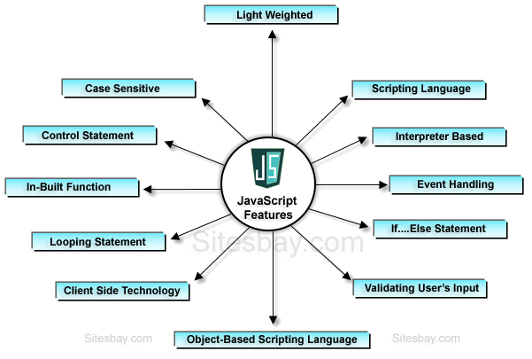

Slide 163
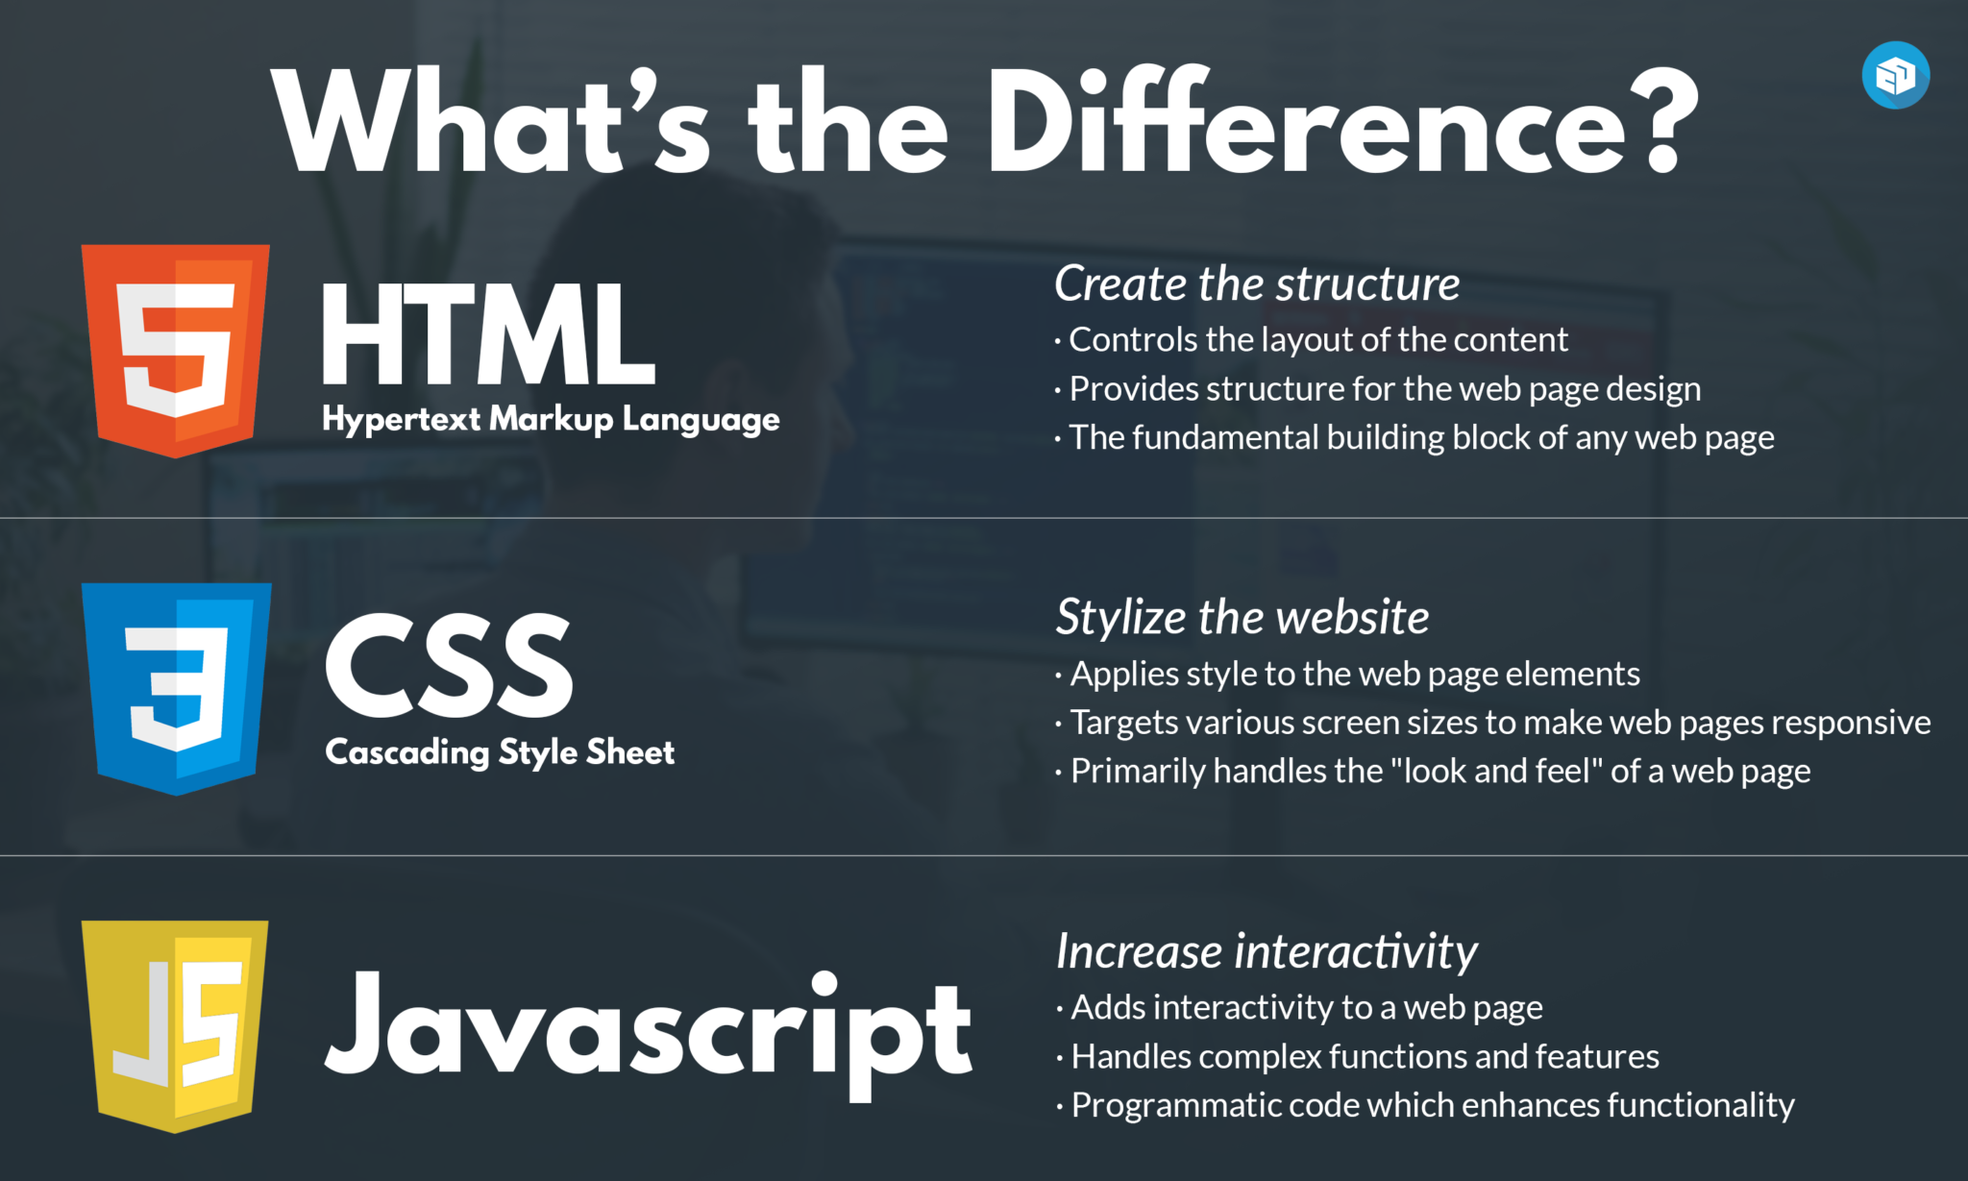

Slide 164
Linking JavaScript to html
Type 1 :
Within Body tag
<body>
<script>
document.write(“Welcome to Livewire”)
</script>
</body>
Type 2:
Within head tag
<head>
<script>
document.write(“Welcome”)
alert(“Welcome”)
</script>
</head>

Slide 165
Linking Javascript to html
Type 3:
By linking external js file
Create a file with .js extension and write script in that file.
Js file :
alert(“Welcome”)
Html file :
<head>
<script optional(type="text/javascript“) src=“filename.js">
</script>
</head>

Slide 166
JavaScript Output
JavaScript can "display" data in different ways:
Writing into an HTML element, using innerHTML.
Writing into the HTML output using document.write().
Writing into an alert box, using window.alert().
Writing into the browser console, using console.log().

Slide 167
Java Script Keywords
Keyword | Description
var | Declares a variable
let | Declares a block variable
const | Declares a block constant
if | Marks a block of statements to be executed on a condition
switch | Marks a block of statements to be executed in different cases
for | Marks a block of statements to be executed in a loop
function | Declares a function
return | Exits a function
try | Implements error handling to a block of statements

Slide 168
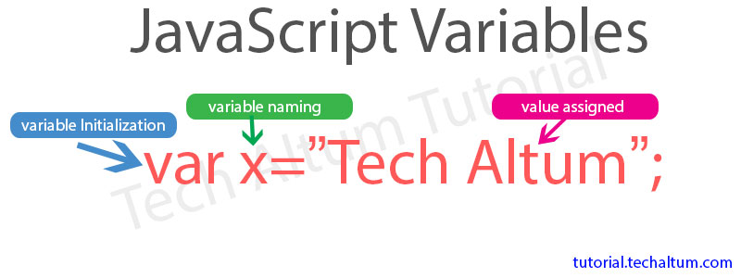
Variables
A JavaScript variable is simply a name of storage location. There are two types of variables in JavaScript : local variable and global variable.

Slide 169
Let, Const, and Var
Always declare JavaScript variables with var,let, or const.
The var keyword is used in all JavaScript code from 1995 to 2015.
The let and const keywords were added to JavaScript in 2015.
If you want your code to run in older browser, you must use var.

Slide 170
Rules for Naming A variable
Name must start with a letter (a to z or A to Z), underscore( _ ), or dollar( $ ) sign.
After first letter we can use digits (0 to 9), for example value1.
JavaScript variables are case sensitive, for example x and X are different variables.

Slide 171
Comments
// - Single line comment
/* */ - Multi line comment

Slide 172
Data Types
Type | Name | Example
Primitive Data Type | String | var a = “Hello”;
 | Number | var a = 90; Var l = 45.5;
 | Boolean | let a = true;
 | Undefined | var a;
Non-Primitive Data Types | Object | var a = {key1:value1,key2:value2,….}
 | Array | var arr = [10,23,324,2]

Slide 173
Type Conversion
parseInt → Converts a string to Integer.
parseFloat → Converts a string to float.

Slide 174
Operators
S. No | Operators | Symbols
1. | Arithmetic Operators | + (Addition)
 |  | - (Subtraction)
 |  | * (Multiplication)
 |  | / (Division)
 |  | % (Modulus)
 |  | ++ (Increment)
 |  | -- (Decrement)
2. | Comparison Operators | ==
 |  | !=
 |  | >
 |  | <
 |  | >=
 |  | <=

Slide 175
S. No | Operators | Symbols
3. | Logical Operators | && (AND)
 |  | || (OR)
 |  | ! (NOT)
4. | Assignment Operators | =
 |  | += // a+=10 (a = a+10)
 |  | -=
 |  | *=
 |  | /=
 |  | %=

Slide 176
S.No | Operator | Name | Description
5. | Bitwise Operators | & (AND) | (OR) ~ (NOT) ^ (XOR) << (LEFT SHIFT) >> (RIGHT SHIFT)
6 | Ternary operator | ? : Condition ? True Part : False Part

Slide 177
Decision Making Statements
If
if(condition){
// Statements }
If – else
if(condition){
// Statements }
else{
// Statements }
Else if
if(condition){
// Statements }
else if(Condition){
// Statements }

Slide 178
Switch Statement
Syntax:
switch(Expression){
case 1: // statements
break;
case 2: // statements
break;
case n: // statements
break
default: // statement
break; }

Slide 179
Looping Statements
For loop
for(initialization;condition;iteration){
// Statements }
While loop
initialization
while(condition){
// Statements
}
Do-while loop
do{
// Statements }
while(condition);
For-each Loop
for (variable of array){
//statements
}

Slide 180
JavaScript Functions
A function allows defining a block of code, which allows executing as many times needed.
Syntax :
Defining a function
function function_name(){
// codes to be executed.
}
Calling a function
function_name();

Slide 181
Arrays
An array is a special variable, which can hold more than one value.
We can create arrays in 2 ways
1. Array literals
Var arr = [item1, item2,item3….]
2. By new keyword
Var arr = new Array(item1,item2,item3….)

Slide 182
Array Methods
Method | Description
join(string) | Joins the elements in an array with specified string
pop() | Removes the last element from array
push(value) | Adds the new element into the array
shift() | Removes the first element from the array
unshift(value) | Adds the element at first

Slide 183
Math
Method | Description
Math.PI | Returns the PI value
Math.round(value) | Rounds to it’s nearest Integer
Math.ceil(value) | Rounded up to its nearest integer
Math.floor(value) | Rounded down to it’s nearest Integer
Math.pow(value, value) | Returns the power
Math.sqrt(value) | Returns the Square Root of the value.
Math.abs(value) | Returns the absolute value
Math.cos(value) | Returns the cos value
Math.sin(value) | Returns the sin value
Math.random() | Returns the random value between 0 and 1

Slide 184
Date
Methods | Description
Var d=new Date() d.getFullYear() | Returns year as a four digit number (yyyy)
d.getMonth() | Returns month as a number (0-11)
d.getDate() | Returns day as a number (1-31)
d.getDay() | Returns weekday as a number (0-6)
d.getHours() | Returns Hours (0-23)
d.getMinutes() | Return Minute(0-59)
d.getSeconds() | Return Seconds(0-59)

Slide 185
Event Handling
The change in the state of an object is known as Event. In html, there are various events which represents that some activity is performed by the user or by the browser.
When java script code is included in HTML, js react over these events and allow the execution.
This process of reacting over the event is called Event Handling.
The DOM(Document Object Model) method is used to succeed the events

Slide 186
Some Important Events
Events | Event Handler | Description
Mouse Events | onclick | When mouse click on the element.
 | onmousedown | When the mouse button is pressed over the element.
 | onmouseup | When the mouse button is released over the element.
 | ondblclick | When mouse click double times on the element.
Keyboard Events | onkeydown & onkeyup | When the user press and then release the keys.

Slide 187
Events | Event Handler | Description
Form Events | onfocus | When the user focuses on the element.
 | onsubmit | When the user submits the form.
 | onblur | When the focus is away from a form element.

Slide 188
JQUERY

Slide 189
Introduction
jQuery is a lightweight, "write less, do more", JavaScript library.
The purpose of jQuery is to make it much easier to use JavaScript on your website.
jQuery takes a lot of common tasks that require many lines of JavaScript code to accomplish, and wraps them into methods that you can call with a single line of code.

Slide 190
Adding jQuery to Your Web Pages
There are several ways to start using jQuery on your web site. You can:
Download the jQuery library from jQuery.com
Include jQuery from a CDN (Content Delivery Network), like Google.

Slide 191
JQuery CDN
If you don't want to download and host jQuery yourself, you can include it from a CDN (Content Delivery Network).
Google is an example of someone who host jQuery
<script src="https://ajax.googleapis.com/ajax/libs/jquery/3.6.0/jquery.min.js"></script>

Slide 192
Syntax
The jQuery syntax is tailor-made for selecting HTML elements and performing some action on the element(s).
Basic syntax is: $(selector).action()
A $ sign to define/access jQuery
A (selector) to "query (or find)" HTML elements
A jQuery action() to be performed on the element(s)

Slide 193
Document Ready Event
All jQuery methods should be inside a document ready event.
This is to prevent any jQuery code from running before the document is finished loading (is ready).
It is good practice to wait for the document to be fully loaded and ready before working with it. This also allows you to have your JavaScript code before the body of your document, in the head section.

Slide 194
Here are some examples of actions that can fail if methods are run before the document is fully loaded:
Trying to hide an element that is not created yet
Trying to get the size of an image that is not loaded yet
$(document).ready(function(){ // jQuery methods go here... });

Slide 195
Examples
Examples:
$(this).hide() - hides the current element.
$("p").hide() - hides all <p> elements.
$(".test").hide() - hides all elements with class="test".
$("#test").hide() - hides the element with id="test".

Slide 196
Sample Program
<head>
<title>JQuery</title>
<script src="https://ajax.googleapis.com/ajax/libs/jquery/3.6.0/jquery.min.js"></script>
</head>
<body>
<p>Click Here</p>
<p>Welcome to Livewire</p>
<p>Jquery Hide Example</p>
<script>
$(document).ready(function(){
$("p").click(function(){
$(this).hide();
});
});
</script>
</body>

Slide 197
Fade Functions
With jQuery you can fade an element in and out of visibility.
Function Used | Description
fadeIn() | fade in a hidden element
fadeIn(milliseconds) | Fade in a hidden element in given time
fadeOut() | Fade out a visible element
fadeOut(milliseconds) | Fade out a visible element in given time.

Slide 198
Slide Functions
With jQuery you can create a sliding effect on elements.
Methods used :
slideDown()
slideUp()
slideToggle()

Slide 199
Animate
The jQuery animate() method is used to create custom animations.
Syntax:
$(selector).animate({params},speed,callback);
$(selector).stop();

Slide 200
SEO
SEO stands for “search engine optimization.” In simple terms, SEO means the process of improving your website to increase its visibility in Google, Microsoft Bing, and other search engines whenever people search for:
Products you sell.
Services you provide.
Information on topics in which you have deep expertise and/or experience.

Slide 201
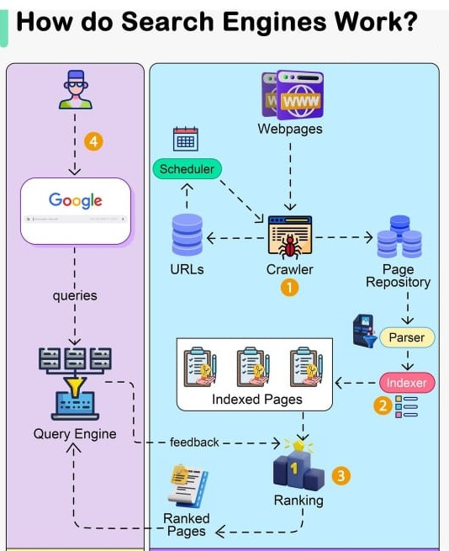

Slide 202
END

